Slide 1
Lesson objective
Need whiteboards.
Title: Fractions and decimals
Aim – be able to:
Use algorithms to add and subtract numbers with decimals
Simplify fractions using common factors
Plan:
Review ordering decimals
Add and take
Simplifying
PBiS focus: Respect
- Communicating using appropriate language.

Slide 2
Questions: MWB
Put these decimals in order from lowest to highest:
a) b)
c) d)
4.6 | 4.06 | 4.26 | 4.16
7.28 | 7.8 | 7.08 | 7.18
5.06 | 5.6 | 5.62 | 5.26
10.94 | 10.24 | 10.04 | 10.4

Slide 3
Adding decimals algorithm (copy MWB)
23.7 + 12.7 =
145.98 + 11.7 =
21.99 + 32.77 =

Slide 4
Subtracting decimals algorithm (Copy MWB)
23.7 - 12.7 =
145.98 - 11.7 =
21.99 - 12.76 =

Slide 5
We do
34.65 + 11.2 =
43.98 – 12.37 =
11.56 + 11.76 =

Slide 6
Individual practice
Sum Fun 51 & 52

Slide 7
Whiteboards
Order these decimals from small to large:
0.21 0.021 0.201 0.02
2. Determine an answer:
23.47 + 11.87 =
19.78 – 4.61 =

Slide 8
How to simplify a fraction:
Find a times table that both top (numerator) and bottom (denominator) are in.
Divide both top and bottom by that number.
Keep going until the only times table that goes into both is the 1 times table.

Slide 9
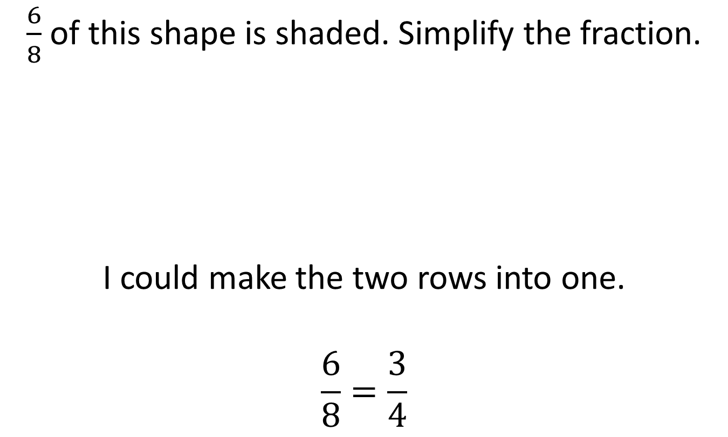
Simplifying using pictures
$\frac{6}{8}$ of this shape is shaded. Simplify the fraction.
I could make the two rows into one.
$$\frac{6}{8}=\frac{3}{4}$$

Slide 10

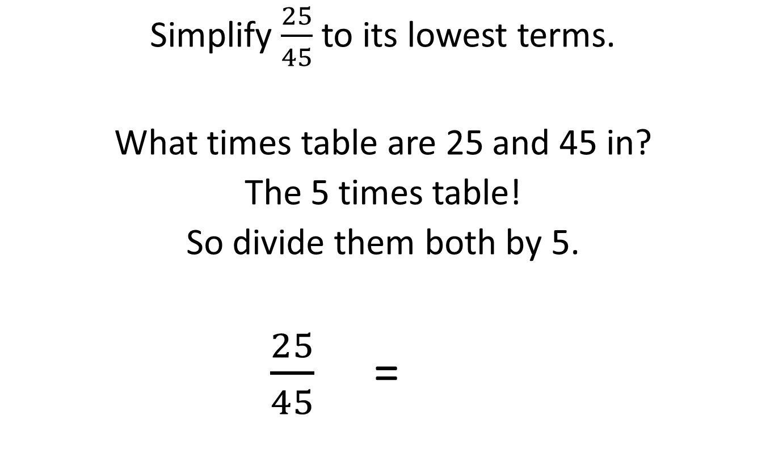
Without a picture, an example:
Simplify $\frac{25}{45}$ to its lowest terms.
What times table are 25 and 45 in?
The 5 times table!
So divide them both by 5.
$\frac{25}{45}$ = .
÷5
$$\frac{5}{9}$$
÷5

Slide 11

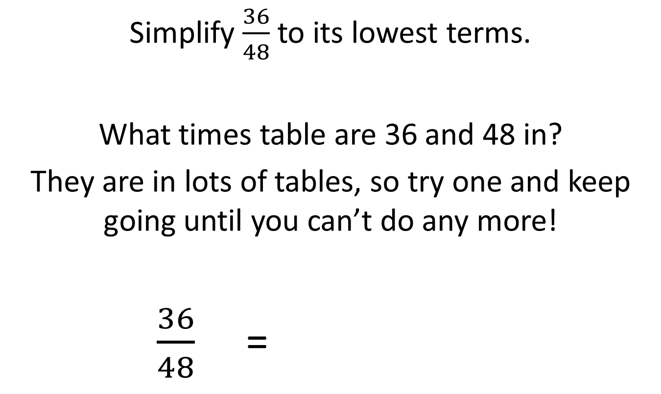

Another example:
Simplify $\frac{36}{48}$ to its lowest terms.
What times table are 36 and 48 in?
They are in lots of tables, so try one and keep going until you can’t do any more!
$\frac{36}{48}$ = .
÷4
÷3
$$\frac{9}{12}$$
=
$$\frac{3}{4}$$
÷4
÷3

Slide 12






Simplify these, giving your answers in their simplest form:
$\frac{24}{30}$
$\frac{35}{49}$
$\frac{28}{42}$
$\frac{16}{48}$
$\frac{18}{42}$
$$\frac{4}{5}$$
$$\frac{5}{7}$$
$$\frac{2}{3}$$
$$\frac{1}{3}$$
$$\frac{3}{7}$$

Slide 13
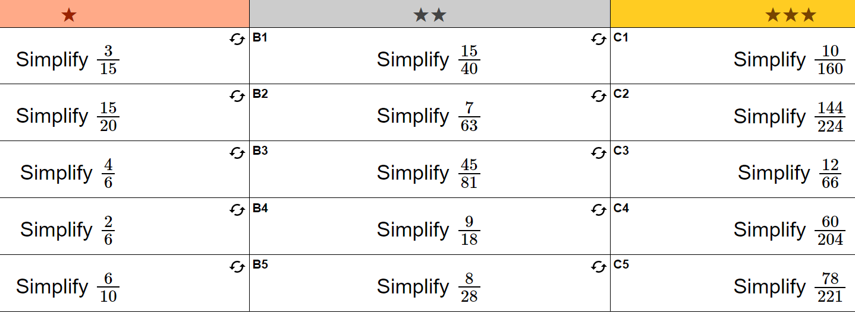

Slide 14
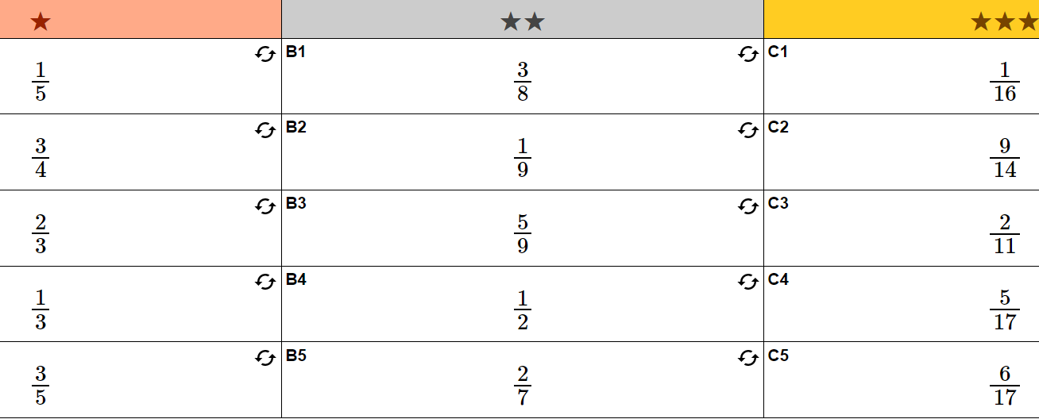

Slide 15
Reflection – Fist to 5
Aim
Order decimals using place value.
Add and subtract numbers with decimals using an algorithm.
Simplify fractions

